Slide 1
Research Problem
Customer churn prediction in telecom using machine learning in big data platform 2019
https://journalofbigdata.springeropen.com/articles/10.1186/s40537-019-0191-6
a) Explain the algorithms involved to solve the research problem in your
research topic / area?
Decision Tree
Random Forest
Gradient Boosted Machine Tree “GBM”
Extreme Gradient Boosting “XGBOOST”

Slide 2
b) For experiments which existing datasets are used?
big raw data provided by SyriaTel telecom company
https://www.kaggle.com/datasets/blastchar/telco-customer-churn

Slide 3
c) What is the evaluation criteria for the experiments?
AUC
Accuracy
Precision/Recall

Slide 4
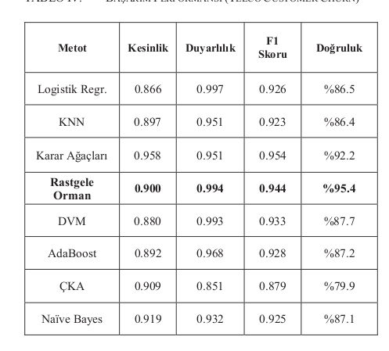
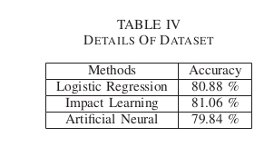
d) Have they compare the results with existing studies? List down
https://ieeexplore.ieee.org/document/9558876 https://ieeexplore.ieee.org/document/9765155

Slide 5
e) Implement at least one algorithm of your choice from the selected
papers (you have to show the coding during presentation)
RF
Logistic Regression
KNN

Slide 6
a) Explain the step by step algorithm involved to solve the research
problem of selected paper.
b) Demonstrate the results
c) Explain your findings / observations

Slide 7
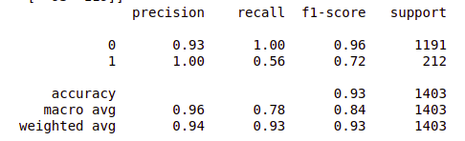
b) Demonstrate the results Random Forest

Slide 8
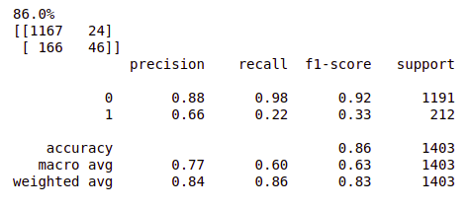
b) Demonstrate the results Logistic Regression

Slide 9
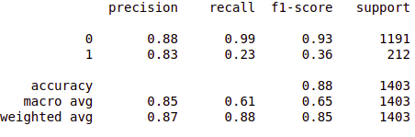
b) Demonstrate the results KNN

Slide 10
Explain your findings / observations
Among the 3 algorithms Random Forest works the best as shown from the AUC, F1 score.
The result may be improved by using a large sample of data

Slide 11
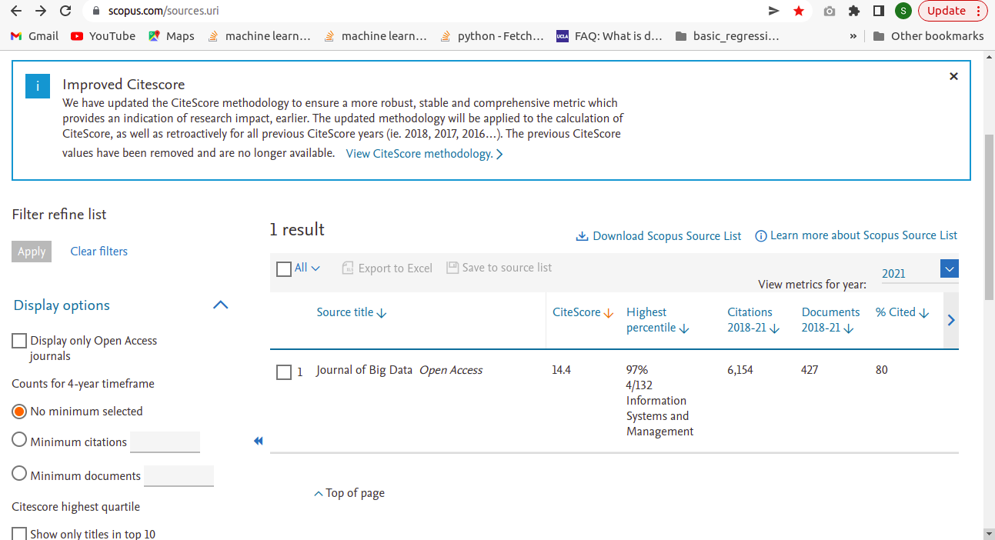
Paper In SCOPUS

